Slide 1
Introduction to Machine Learning
Eddy
Machine Learning Enthusiastic
www.github.com/EddyHu71

Slide 2
About this Class
Date and Time | Topics
07 June 2020 | Introduction to Machine Learning
14 June 2020 | Introduction to Supervised Learning
21 June 2020 | Study Case : Covid-19 Predicition
28 June 2020 | Introduction to Unsupervised Learninig and Reinforcement Learning

Slide 3


Example :

Slide 4
What is machine learning?
Machine learning (ML) is the study of computer algorithms that improve automatically through experience. (wikipedia)

Slide 5
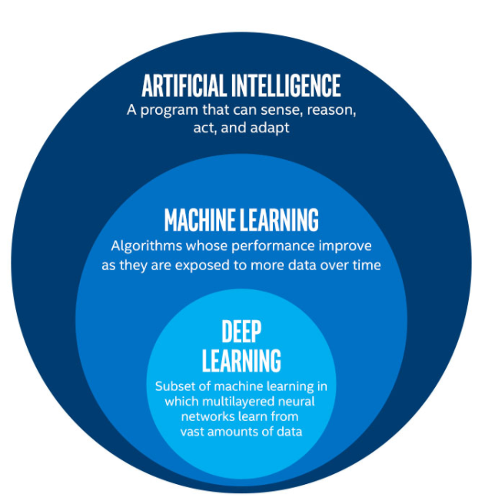

Slide 6
Machine Learning Diagram Model

Slide 7
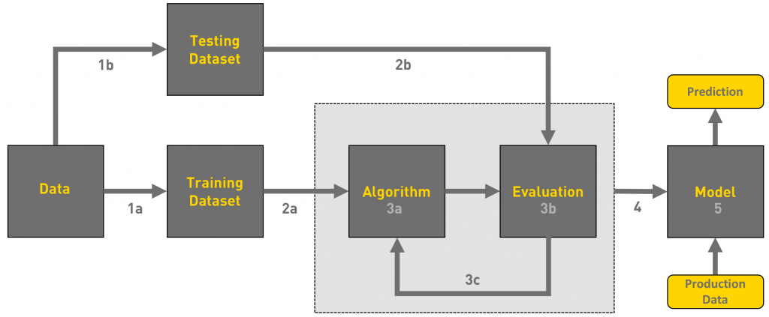

Slide 8
Type of Machine Learning Algorithm

Slide 9
Supervised Learning

Slide 10
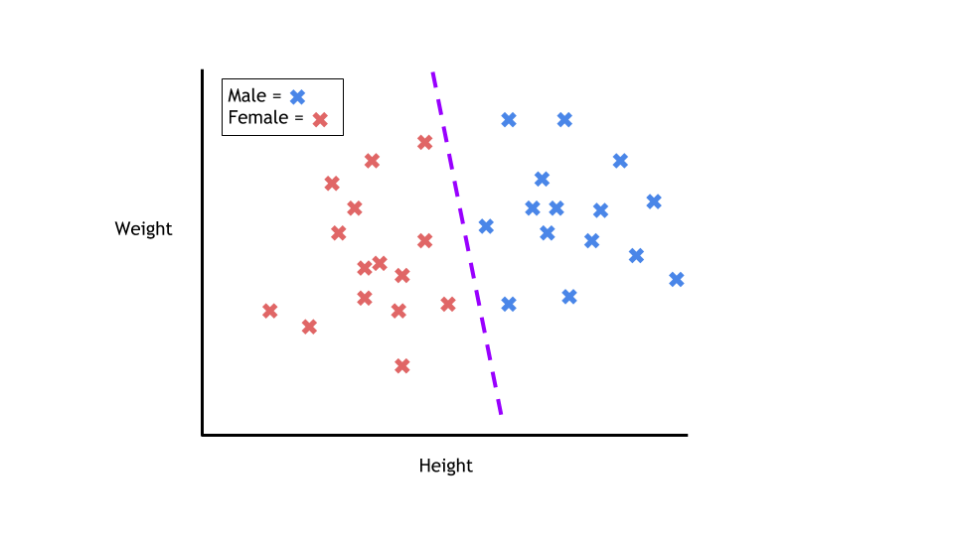
1. Classification

Slide 11
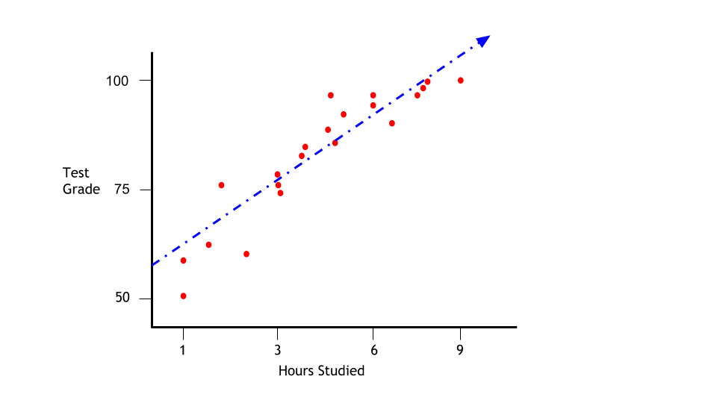
2. Regression

Slide 12
Unsupervised Learning

Slide 13
Descriptive Learning
Come up the future ideas based on the dataset

Slide 14
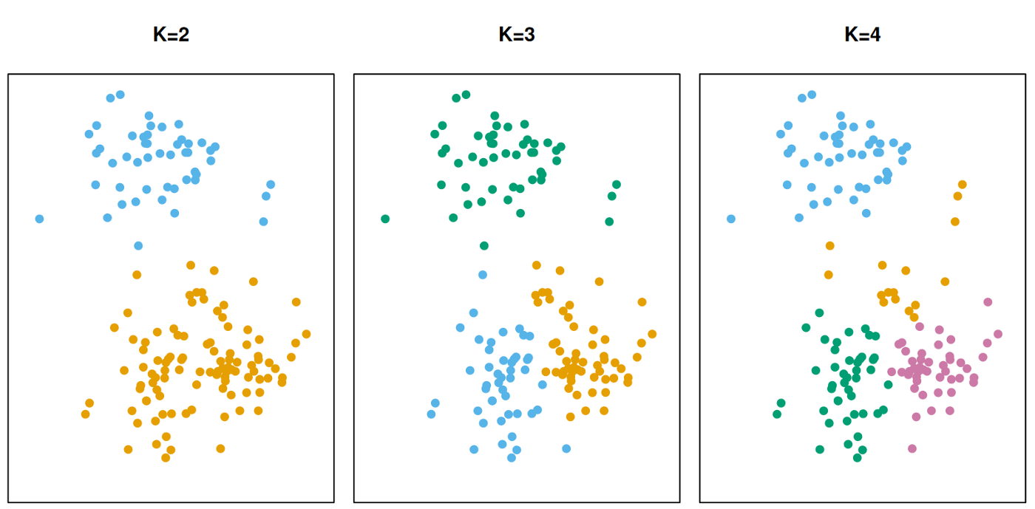
2. Clustering

Slide 15
Reinforcement Learning

Slide 16
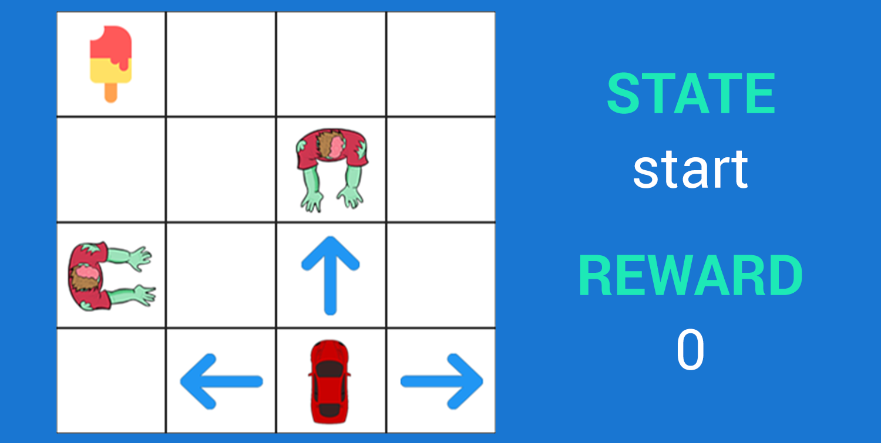
Reinforcement Learning

Slide 17
Special Thanks to
Towards Data Science (https://towardsdatascience.com/)
Medium (https://medium.com/)
Quora (https://www.quora.com/)
Wikipedia (https://www.wikipedia.org/)
Insane (https://www.facebook.com/TheInsaneApp/)

Slide 18
Assignment
Find the difference between data science and machine learning.
Learn one supervised learning algorithm.

